Slide 1
5 testing packages to make your package better!
Pawel Rucki

Slide 2
About me
Pawel Rucki
Senior Statistical Programmer Analyst @ Roche
Product owner & engineering team lead
www.linkedin.com/in/pawel-rucki

Slide 3
Static code analysis - what? why? how?
Static code analysis is examining the source code before it is run.
Active code analysis: check if foo() gives correct output
Static code analysis: check if foo is correctly written
✔ Increase code quality!
✔ Speed - detect the bugs earlier and faster
✔ Coverage - not everything can be tested manually
✔ Accuracy - eliminate human factor
✖ Sometimes gives false positives

Slide 4


Testing tools you might already know
{{testthat}} is a testing framework for writing unit tests. Usually unit tests are testing functions via expectations. That is not necessarily static code analysis.
{{covr}} is a wrapper on {{testthat}} that gives you number. Again, it's not necessarily static code analysis.
Most of R CMD BUILD and R CMD CHECK steps are definitely a static code analysis.

Slide 5
What are the other tools?

Slide 6

ropensci/spelling
Spell checking common document formats including latex, markdown, manual pages, and description files.
Spell check single files or the whole package (documentation, description, readme, and vignettes) spell_check_files(<path>) spell_check_package()

Slide 7
ropensci/spelling
Add unit tests spell_check_setup() But: this unit test just prints the outcome - would never fail.
WORDLIST A file with all exceptions.
Pro-tips:
Make sure you fail on error.
Use WORDLIST only when necessarily. E.g. wrap-up technical terms in appropriate markdown tag \code{}, use quotation marks.
Prepare for many errors on the very first run 😉

Slide 8

dreamRs/prefixer
Prefix function with their namespace & other development tools
Checks if the imported functions (in the NAMESPACE file) are actually used in the code check_import_from()
Checks if each function documentation have an example and a return value check_Rd_examples() check_Rd_value()

Slide 9
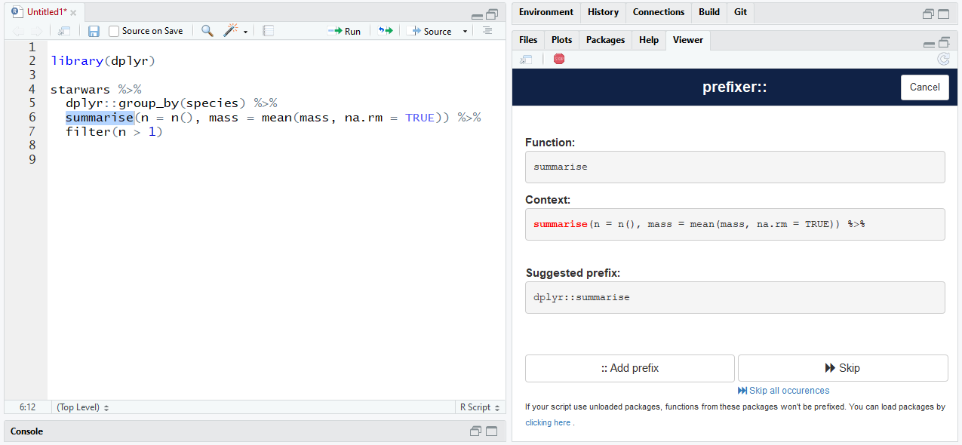
dreamRs/prefixer - shiny widget
source: package documentation

Slide 10
{{codetools}}
Code analysis tools for R.
Check usage of a closure(s): checkUsage(fun) checkUsageEnv(env) checkUsagePackage(pack)
An example output: my_custom_fun: local variable ‘x’ assigned but may not be used
No hex :(

Slide 11
(some random spiderman gif to bring your attention!)

Slide 12
jimhester/lintr
Static code analysis for R.
22 default linters (lintr::default_linters):
commented_code_linter
cyclocomp_linter
namespace_linter
object_length_linter
object_usage_linter
it does use {{codetools}} under the hood!
...
No hex :(

Slide 13
jimhester/lintr
Compatibility with RStudio, VSCode, Vim, Atom, Emacs, Sublime Text
.lint file with settings / exclusions
Inline exceptions: foo() # nolint # nolint start bar() ... baz() # nolint end
Prepare for many errors on the very first run 😉
really, a lot of errors

Slide 14
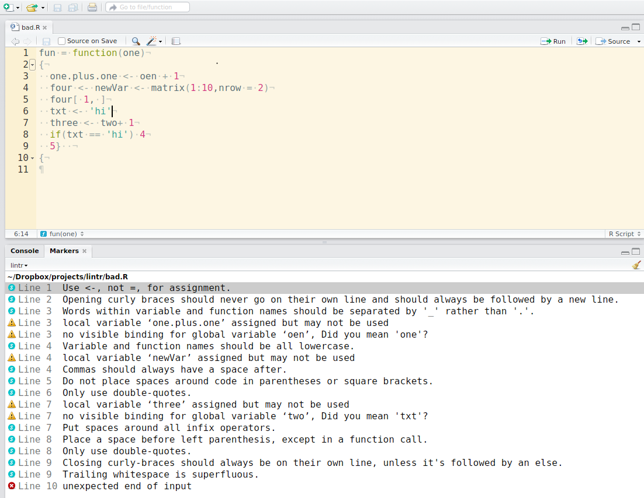
source: package documentation

Slide 15

MangoTheCat/goodpractice
Advice on R Package Building.
One main function to rule run it all!
gp("<my-package>")
It combines R CMD CHECK, covr, (some) lintr checks and a little more (230 checks in total!) into one big, human-readable report.

Slide 16
#> ── GP badpackage ──────────────────────────────────────────────────────────
#>
#> It is good practice to
#>
#> ✖ not use "Depends" in DESCRIPTION, as it can cause name
#> clashes, and poor interaction with other packages. Use
#> "Imports" instead.
#> ✖ omit "Date" in DESCRIPTION. It is not required and it gets
#> invalid quite often. A build date will be added to the package
#> when you perform `R CMD build` on it.
#> ✖ add a "URL" field to DESCRIPTION. It helps users find
#> information about your package online. If your package does
#> not have a homepage, add an URL to GitHub, or the CRAN package
#> package page.
#> ✖ add a "BugReports" field to DESCRIPTION, and point it to a bug
#> tracker. Many online code hosting services provide bug
#> trackers for free, https://github.com, https://gitlab.com,
#> etc.
#> ✖ omit trailing semicolons from code lines. They are not needed
#> and most R coding standards forbid them
#>
#> R/semicolons.R:4:30
#> R/semicolons.R:5:29
#> R/semicolons.R:9:38
#>
#> ✖ not import packages as a whole, as this can cause name clashes
#> between the imported packages. Instead, import only the
#> specific functions you need.
#> ✖ fix this R CMD check ERROR: VignetteBuilder package not
#> declared: ‘knitr’ See section ‘The DESCRIPTION file’ in the
#> ‘Writing R Extensions’ manual.
#> ✖ avoid 'T' and 'F', as they are just variables which are set to
#> the logicals 'TRUE' and 'FALSE' by default, but are not
#> reserved words and hence can be overwritten by the user.
#> Hence, one should always use 'TRUE' and 'FALSE' for the
#> logicals.
#>
#> R/tf.R:NA:NA
#> R/tf.R:NA:NA
#> R/tf.R:NA:NA
#> R/tf.R:NA:NA
#> R/tf.R:NA:NA
#> ... and 4 more lines
#>
#> ───────────────────────────────────────────────────────────────────────────
source: package documentation

Slide 17

OK now we know what but how?

Slide 18
How to add static code analysis?
Each of presented functions returns an object on which you can put a testthat expectation and add it to your package tests: testthat::expect_length(lintr::lint_package(), 0) testthat::expect_silent(prefixer::check_import_from())
BUT: is this the right thing to do?

Slide 19
Our practice to introduce a static code analysis
At first we created a small package to group it all into one place and run it for all the other packages
Yet another package dependency to maintain
Yet another package to include in the release cycle
Some of the checks are quite long (especially lintr)
Easy to mix development and business unit tests
Then we decided to keep business unit tests and start to move static code analysis somewhere else. Where?

Slide 20
GitHub Actions FTW!
There are plenty of ready to use actions available in its Marketplace such as URL checks, lint (that uses lintr under the hood), etc.
It's relatively easy to create your custom action.
Still in progress but the results are very promising!

Slide 21

THANK YOU!

